Slide 1


India General Election Results – 2024
A comprehensive dashboard analysis of the 2024 Indian general election results

Slide 2
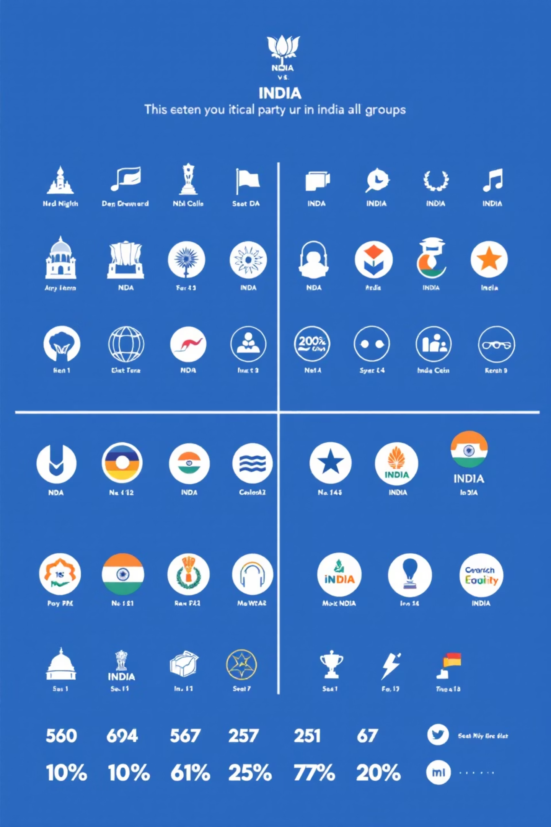
Dashboard 1: Overview Analysis
NDA Performance
1
Total seats won & percentage of total seats, detailed grid table
I.N.D.I.A. Performance
2
Total seats won & percentage of total seats, detailed grid table
Independent & Others
3
Total seats won & percentage of total seats
Features: Alliance-wise party breakdown with seat counts.

Slide 3
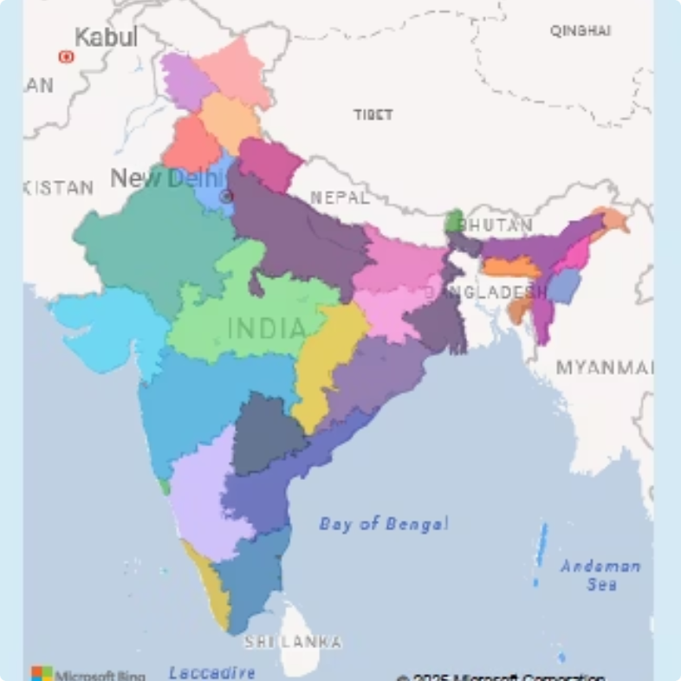
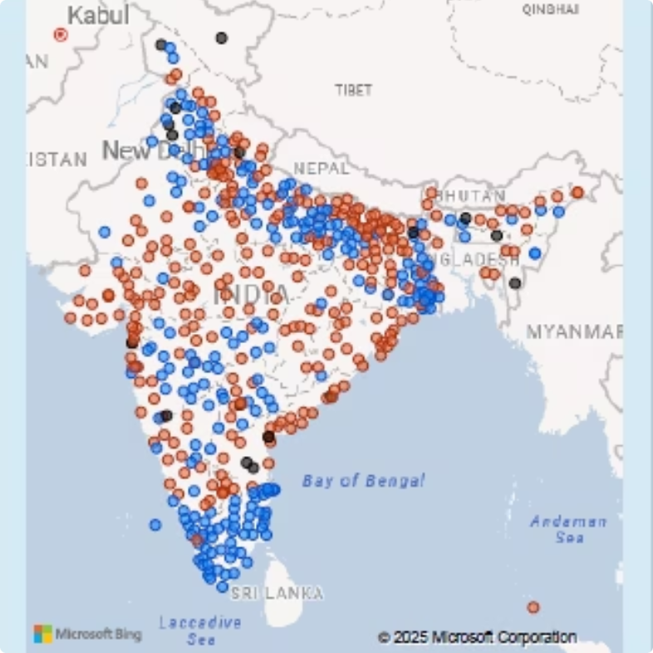
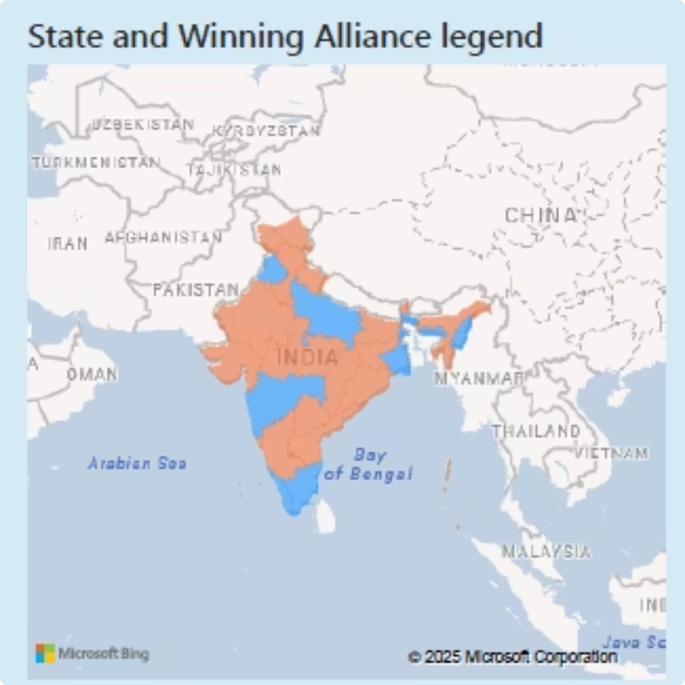
Dashboard 2: State Demographic Analysis
A closer look at the electoral dynamics and shifts within individual states, revealing the nuances of the 2024 results.
State Level Analysis
Alliance Dominance
Evolving Voter Trends
Total seats, majority alliance, NDA & I.N.D.I.A. seats by state
Examination of regions where NDA or I.N.D.I.A. secured overwhelming victories, revealing entrenched support bases.
Insights into how evolving voter behaviors, age groups, and urban-rural divides influenced electoral results across states.

Slide 4


Dashboard 3: Political Landscape by State
—
KPIs
Seats won by NDA, I.N.D.I.A., and Independent/Other parties.
Visuals
State map showing constituency boundaries.
Party-wise seat share (donut chart).
Grid view of party results with alliance info.
Dynamic state selection with map chart and party-wise results

Slide 5
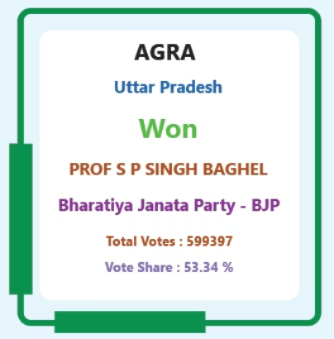
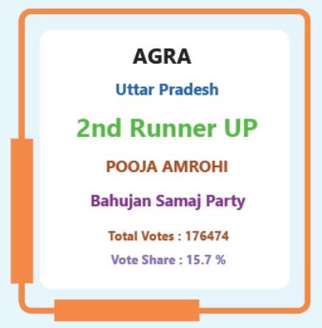
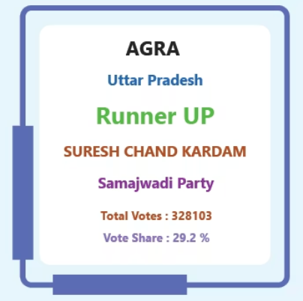
Dashboard 4: Constituency Analysis
Deep dive into voter data
Primary KPIs
Candidate Performance For AGRA
Total Votes
EVM Votes
Postal Votes
Total Candidates
Secondary KPIs
Winning Party details
runner-up Party details
second runner-up candidate details.

Slide 6

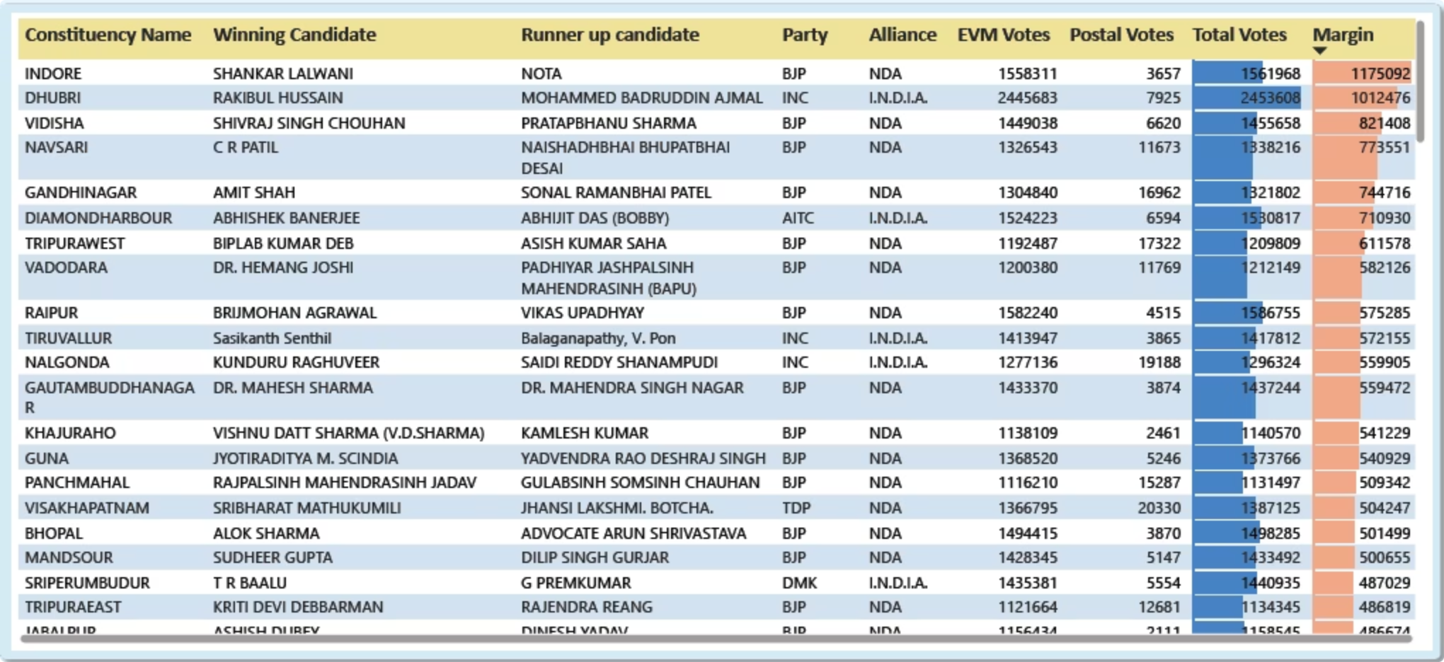



Dashboard 5: Details Grid
Comprehensive Data
Feature
Constituency, winning & runner-up candidates, party, alliance, votes, margin
Full tabular results with drill-through capability.
Data export to Excel.

Slide 7







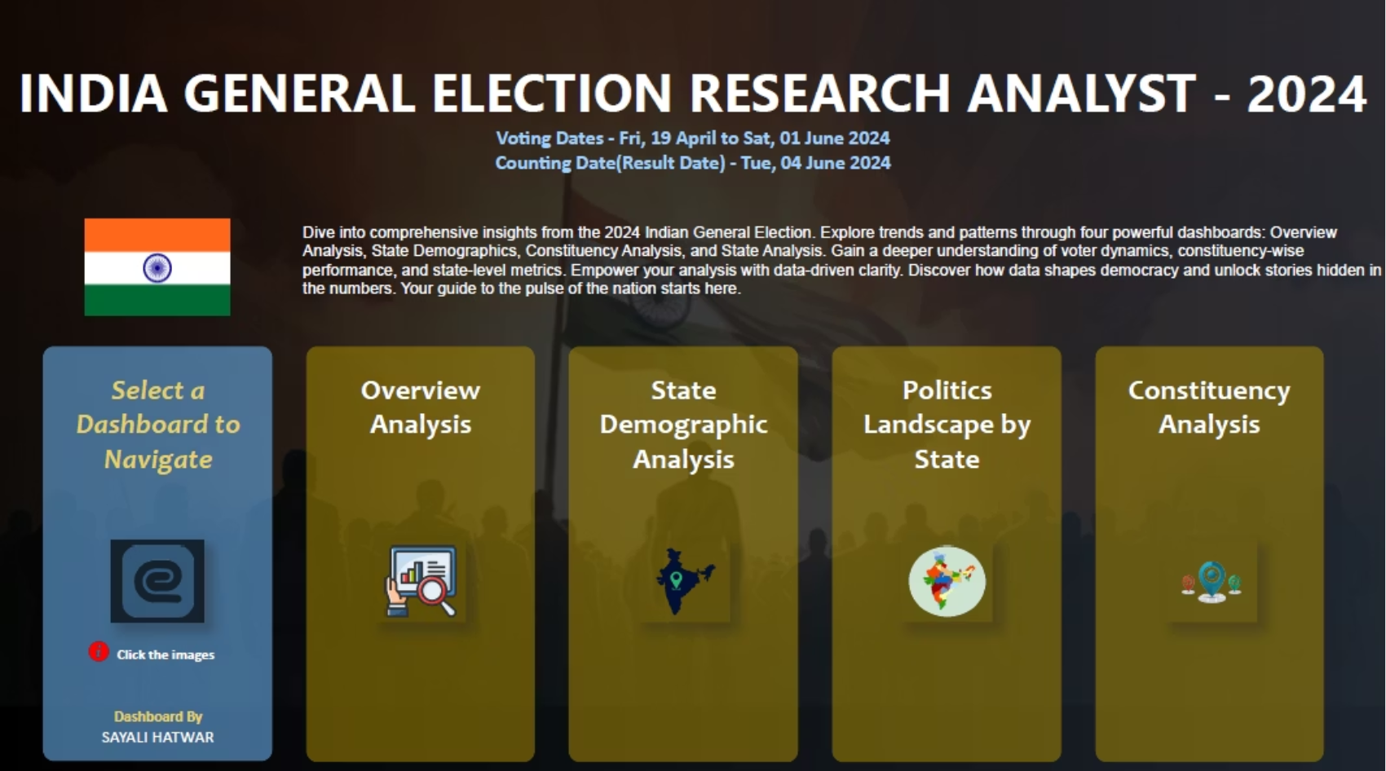
Dashboard 6: Landing Page
Central navigation hub with quick access to all dashboards
Navigation Menu
Responsive Design
Clean Interface
Clickable buttons to all dashboards
Optimized for all screen sizes & Home button on every page.
Minimalist clean design with intuitive icons, color coding, and hover effects.

